Slide 1
Imaging in trauma
Tutorial

Slide 2
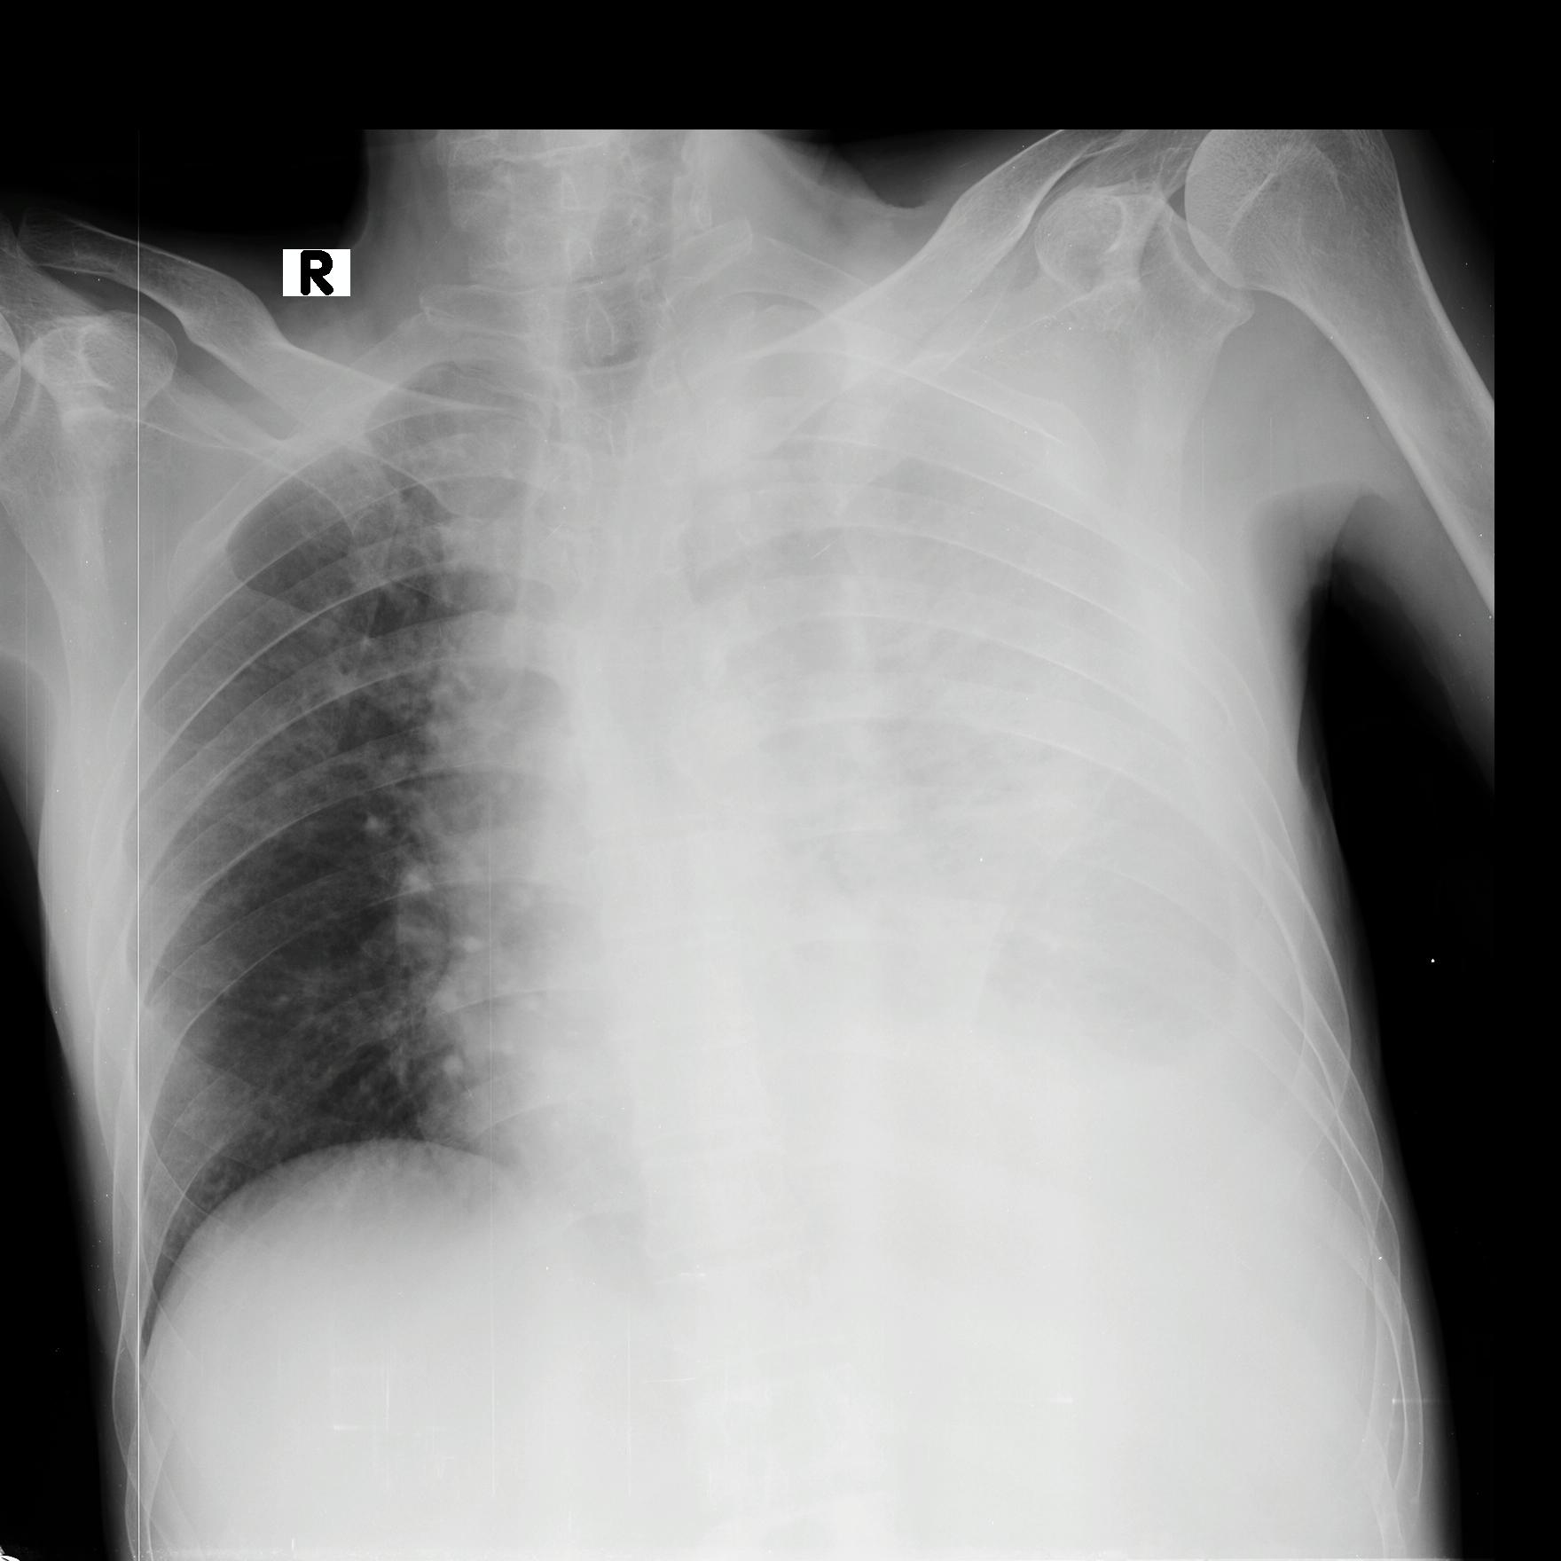
1 A 35-year-old male presented to the ETU with SOB following a RTA
1.1 Identify the image.
1.2 Describe the radiological abnormalities.
1.3 What is the diagnosis?

Slide 3
2 A 40-year-old male presented with shortness of breath following a chest wall trauma
2.1 Identify the image.
2.2 Describe the radiological abnormalities.
2.3 What is the diagnosis?
2.4 What is the immediate management of the above condition.

Slide 4
3 A 39-year-old female presented to the ETU following a road traffic accident
L
3.1 Identify the image.
3.2 Give four radiological signs
seen in this image
3.3 What is the diagnosis?
L

Slide 5
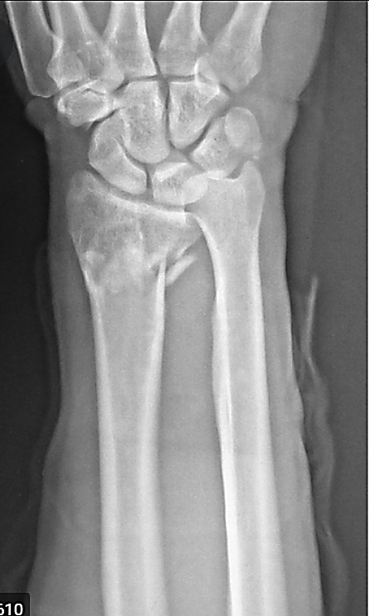
4 A 65-year- old female following a fall on outstretched hand
A
B
4.1 Identify the images A and B.
4.2 Describe the radiological abnormalities.
4.3 What is the diagnosis?
L

